Slide 1
Boosting Algorithm
Reggression

Slide 2
Boosting Algorithm-Regression
Adaptive Boosting- Ada Boost
Extreme Gradient Boosting - XGBoosting
Light Gradient Boosting – LGB model

Slide 3
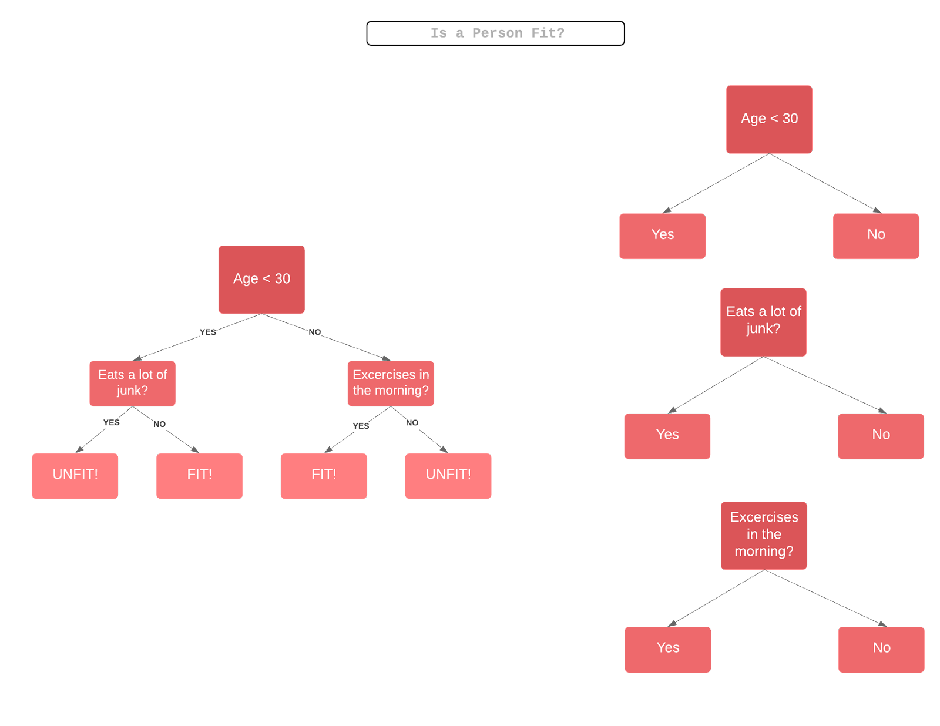
Ada Boosting

Slide 4
Advantages Disadvantages
used to improve the accuracy
Used in binary classification
Text classification
Image classification
Use adaboost with SVM to avoid overfitting
Needs quality data
Sensitive to noisy data

Slide 5
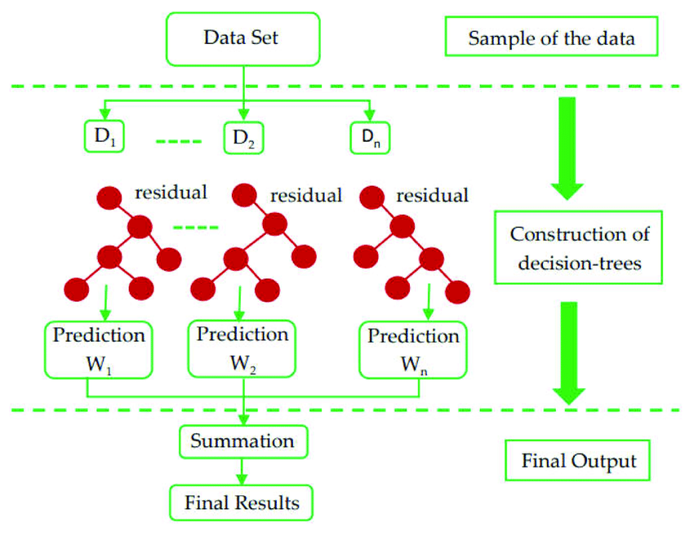
XG Boosting

Slide 6
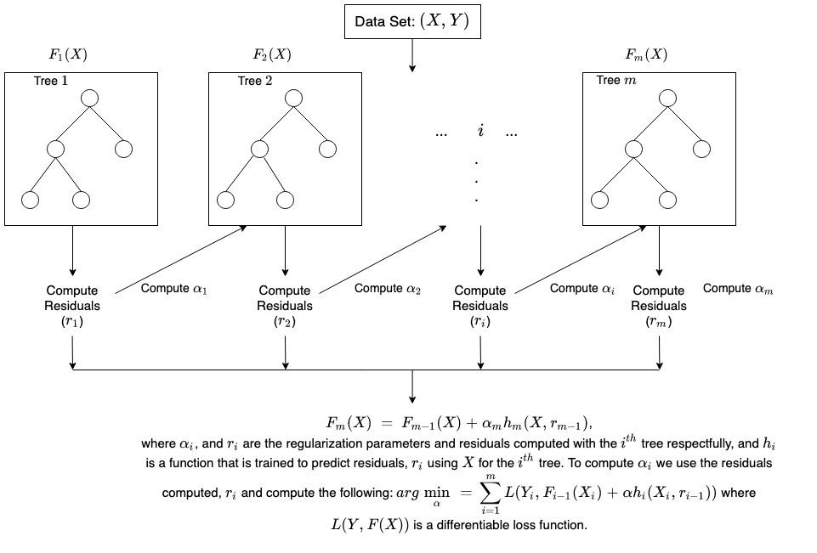

Slide 7
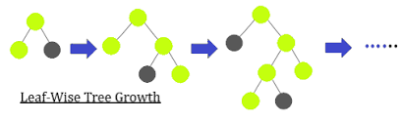
Light Gradient Boosting

Slide 8
LightGBM is a practical boosting framework that uses leaf-wise tree-based growth.
Light GBM is almost 7 times quicker than XGBOOST, hence a much better approach when dealing with large datasets in limited-time competitions.
LightGBM achieves the speed by downsampling the features and speeding up tree learning. It is done with the help of exclusive bunding features.

Slide 9
Advantages
It can be used for classification and regression problems.
Fast training speed and higher efficiency
Better accuracy than any other boosting algorithm
Require less memory
Compatible with large datasets

Slide 10
Thank you

